Slide 1
PRIVATE SCHOOLS
SSC NR Section confirmation’

Slide 2
Open the website of Directorate of Government Examinations Andhra Pradesh : www.bseap.org
You will get the below web page.
Click on the ‘SSC Nominal Rolls-March 2019 Regular link’

Slide 3
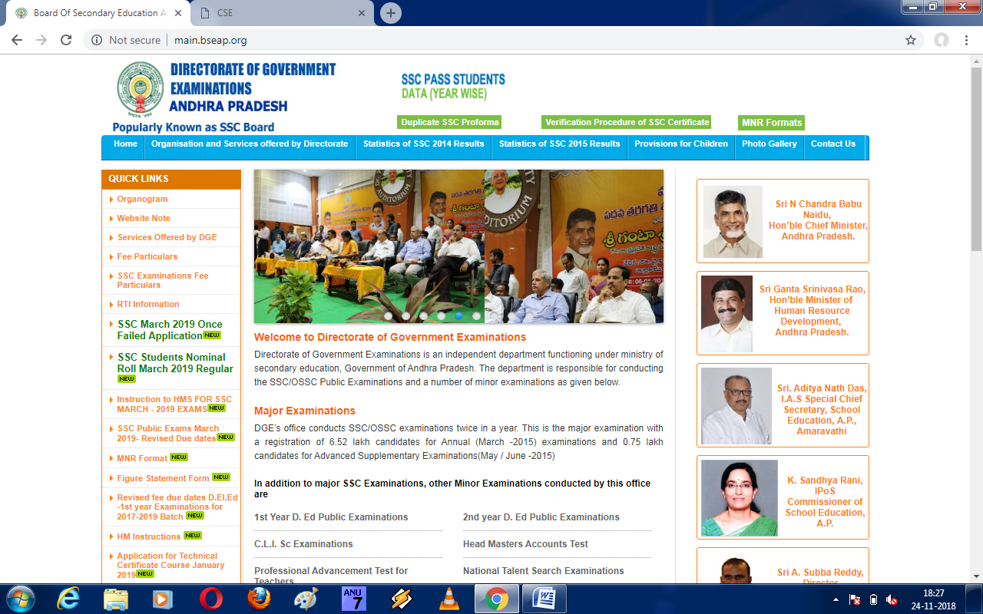

Slide 5
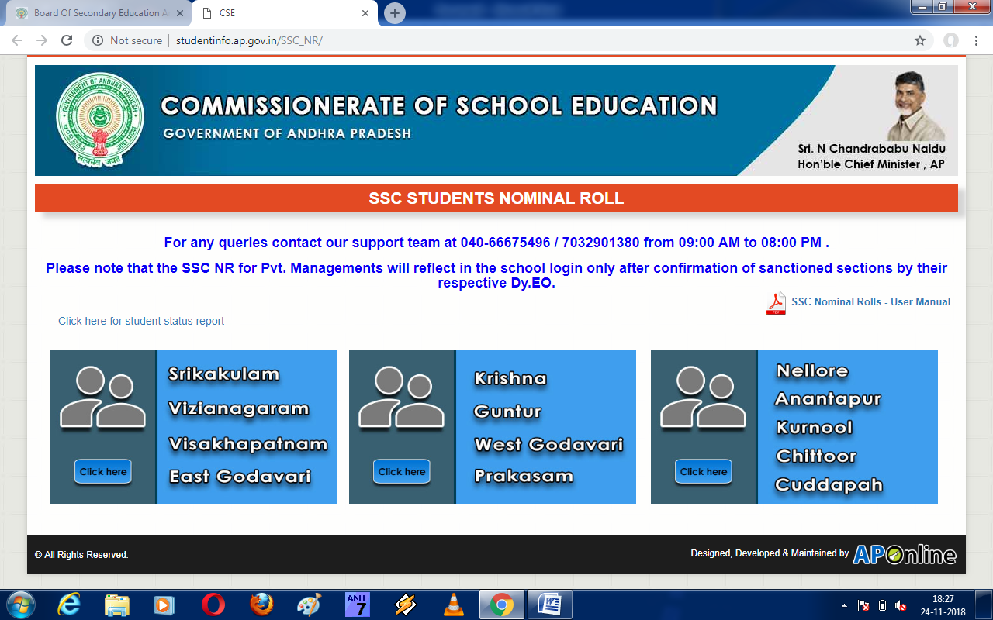
SELECT YOUR DISTRICT

Slide 6
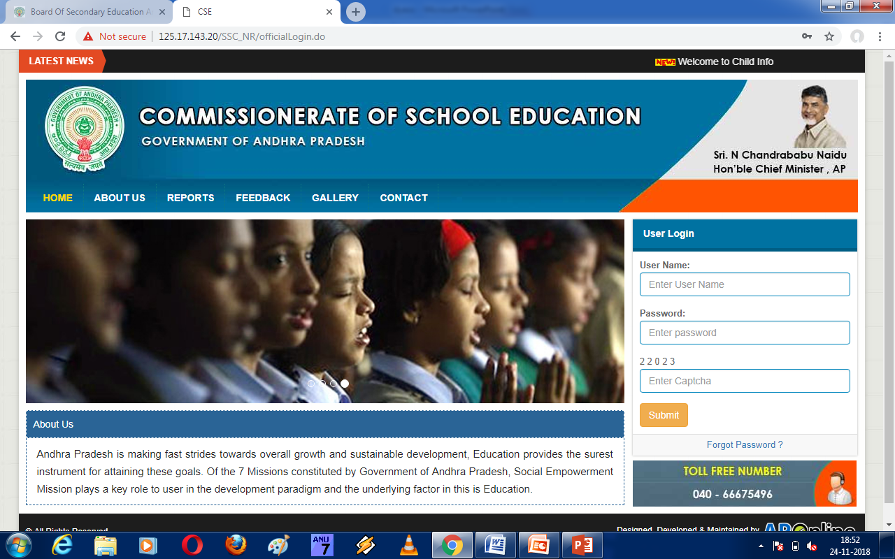
ENTER DYEO USER NAME & PASSWORD (CSE) & CAPTURE CODE

Slide 8
ENTER DYEO USER NAME & PASSWORD (CSE) & CAPTURE CODE

Slide 9
Enter dyeo user name & password (cse) & capture code after submit You will get the below page

Slide 10
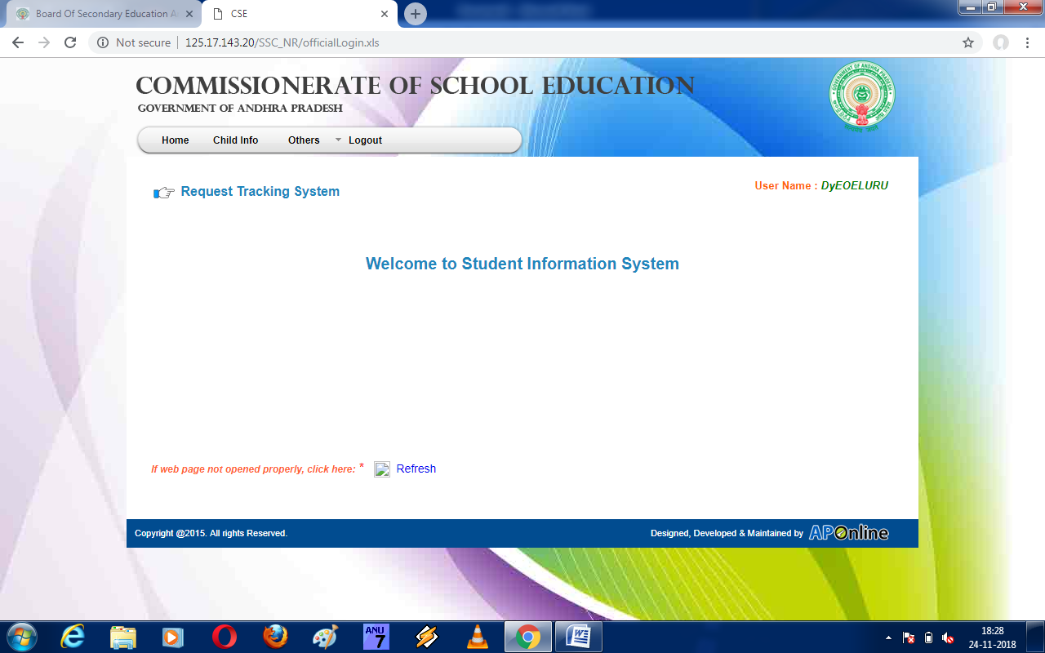

Slide 11
In The above page click the 3rd one means ‘Others button’ and drop down box select ‘SSC NR Section confirmation’

Slide 12
In The above page click the 3rd one means ‘Others button’ and drop down box select ‘SSC NR Section confirmation’

Slide 13
We will get that ‘SSC NR Section confirmation’ that is shown in the below

Slide 14
First select Mandal Name

Slide 15
Select Mandal Name

Slide 16
SelectVillage Name

Slide 17
Select Village Name

Slide 18
Select School Name

Slide 20
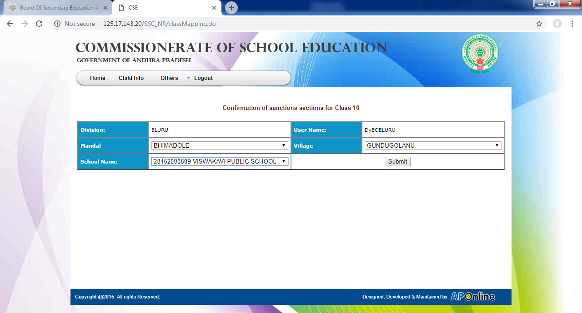
Select School Name

Slide 21
Click submit we will get bellow page

Slide 22
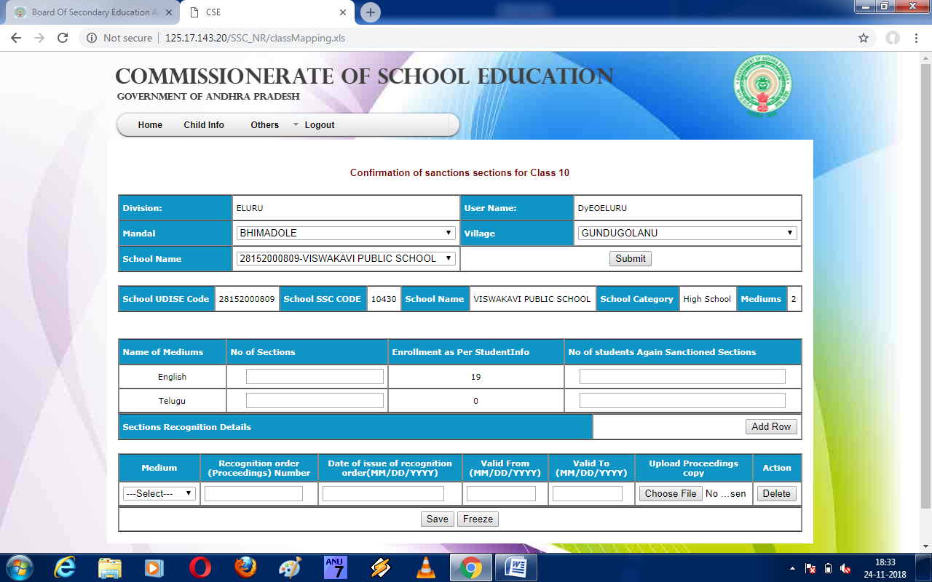

Slide 23
Enter no of sections medium wise

Slide 24
Enter no of sections medium wise

Slide 25
Enter no of students again sanctioned sections medium wise

Slide 26
Enter no of students again sanctioned sections medium wise

Slide 27
Enter Recognition number , sanction date, valid from to dates

Slide 28
Enter Recognition number , sanction date, valid from to dates

Slide 29
Up load Recognition copy only PDF file

Slide 30
Up load additional Sections or other medium permission copy add row

Slide 31
We will get another row as shown below

Slide 32
After complete upload reg. copy click save

Slide 34
After complete upload reg. copy click save

Slide 35
click save button after click freeze button
Student details transfer to above select school.

